Slide 1

HOLMUSK DATA CHALLENGE
Jon Barrenetxea
25.1.2022

Slide 2
Problem Statement
Drug A and Drug B are prescribed to patients with a specific condition
Patients are monitored for bleeding events since treatment initiation
The goal is to compare the risk of Drugs A and B for the occurrence of bleeding events using real-world data

Slide 3
Analytical strategy outline
Cleaning
Exploratory analysis
Descriptive statistics (overall and by treatment)
Kaplan Meier curves
Base Cox model
Statistical analysis
Estimation of propensity scores
Survival regression with propensity scores
Identification of confounders with multivariable models
Check missing data/Fill missing values
Hot encoding
Dimensionality reduction

Slide 4
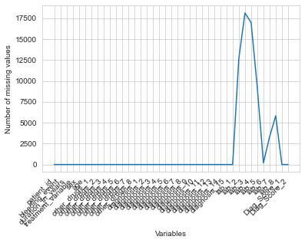
Inspecting missing values
‘lab_2’ – ‘lab_8’ variables to have considerable missing data
Cleaning
Exploratory analysis
Statistical analysis

Slide 5
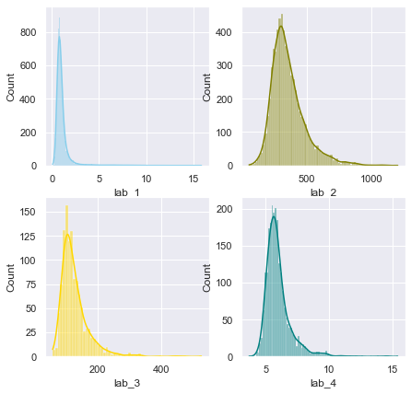
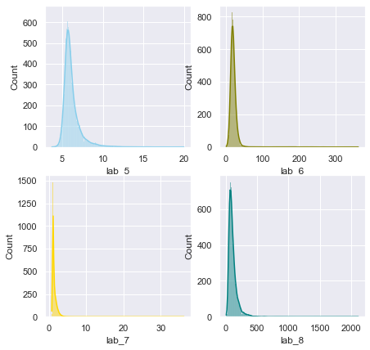
Skewed distribution of ‘lab_x’ variables: replaced missing values with median
Cleaning
Exploratory analysis
Statistical analysis
Notes:
Skewed data for missing values, use fill.na function to replace missing values with medians

Slide 6
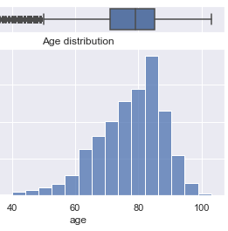
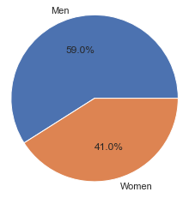
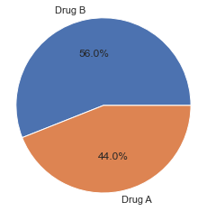
Descriptive statistics
Old cohort (mean age 77 years)
59% men
56% took drug B
Cleaning
Exploratory analysis
Statistical analysis

Slide 7
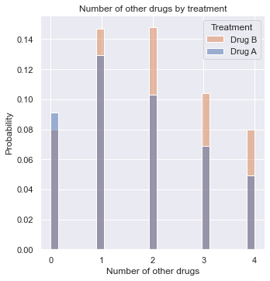
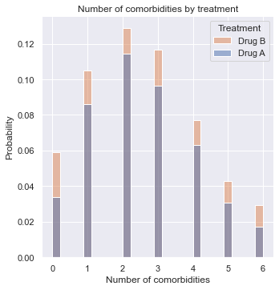
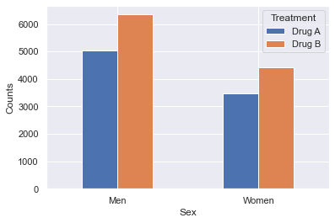
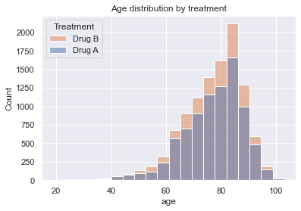
Descriptive statistics by treatment
Those with no other drugs are more likely to be treated with Drug A
No evidence of different treatment distributions by age, gender and number of comorbidities
Cleaning
Exploratory analysis
Statistical analysis

Slide 8
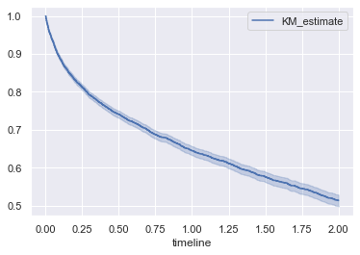
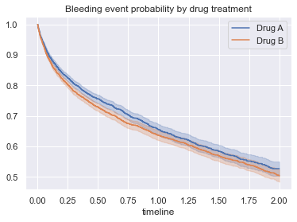
Kaplan Meyer Curve for probability of bleeding event over time
Probability of bleeding event decreases exponentially over time
Probability of bleeding event appears to be slightly higher for Drug A, particularly between the 4-12 month period after treatment
However, overlapping confidence intervals suggest that any treatment effect to be mild
Cleaning
Exploratory analysis
Statistical analysis
Notes:
he y-axis represents the probability a bleeding event and the x axis is the time in years. We observe that the probability of a bleeding event decreases with time in an exponential fashion.

Slide 9
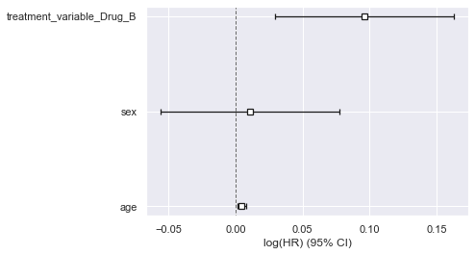
Base Proportional Hazards (PH) model
 | Hazard Ratio (HR) | 95% CI | z | P-value
age | 1.00 | 1.00-1.01 | 3.05 | <0.005
Sex (Women) | 1.01 | 0.95-1.08 | 0.33 | 0.74
Drug B treatment | 1.10 | 1.03-1.18 | 2.84 | <0.005
According to the base model (adjusted for age and sex), those taking Drug B are 10% more likely to have a bleeding event than those taking Drug A
Cleaning
Exploratory analysis
Statistical analysis

Slide 10
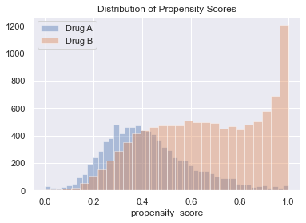
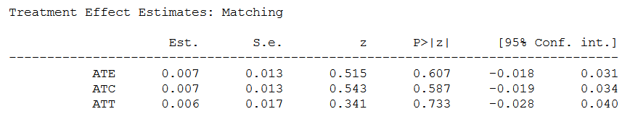
Dealing with confounding I: Estimating treatment effect through propensity score matching
Cleaning
Exploratory analysis
Statistical analysis

Slide 11
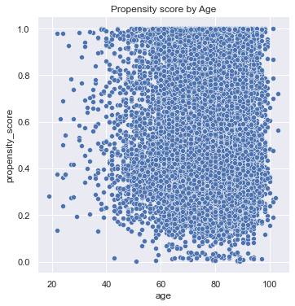
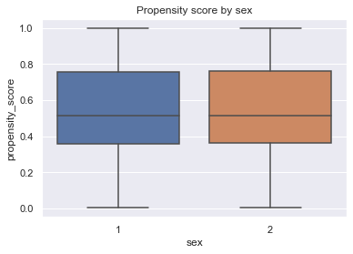
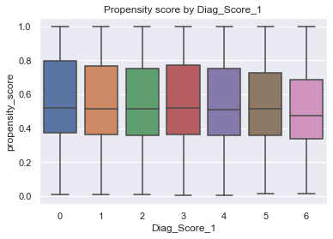
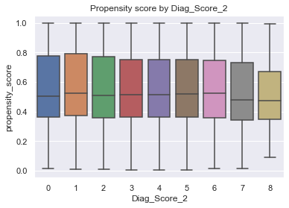
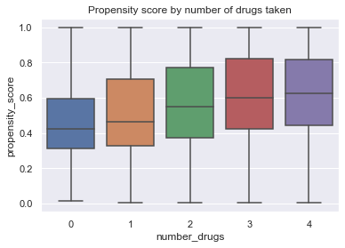
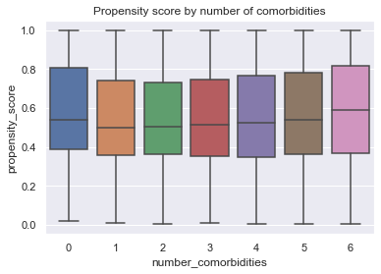
Propensity score distribution pattern across different confounders
Except for number of drugs, there is no obvious distribution pattern of propensity scores for the rest of the covariates
Those with more number of drugs are more likely to be treated with Drug B
Cleaning
Exploratory analysis
Statistical analysis
Notes:
If this happens, it means that positivity is not very strong. If a treated has a propensity score of, say, 0.9 and the maximum propensity score of the untreated is 0.7, we won’t have any untreated to compare to the individual with the 0.9 propensity score. This lack of balancing can generate some bias, because we will have to extrapolate the treatment effect to unknown regions. Not only that, entities with very high or very low propensity scores have a very high weight, which increases variance. As a general rule of thumb, you are in trouble if any weight is higher than 20 (which happens with an untreated with propensity score of 0.95 or a treated with a propensity score of 0.05).
An alternative is clipping the weight to be at a maximum size of 20. This will decrease the variance, but it will actually generate more bias. To be honest, although this is a common practice to reduce variance, I don’t really like it. You will never know if the bias you are inducing with clipping is too much. Also, if the distributions don’t overlap, your data is probably not enough to make a causal conclusion anyway. To gain some further intuition about this, we can look at a technique that combines propensity score and matching

Slide 12
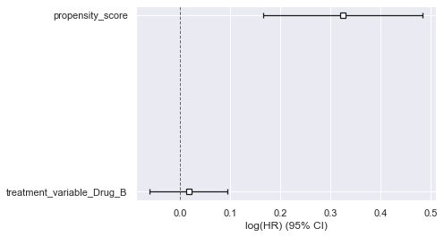
Dealing with confounding II: Accounting for propensity scores in survival regression model
 | HR | 95% CI | z | p
Propensity scores | 1.38 | 1.18-1.62 | 4.01 | <0.005
Drug B treatment | 1.02 | 0.94-1.10 | 0.42 | 0.67
After accounting for propensity scores, we find no evidence of differences between drugs A and B for the occurrence of bleeding events
Cleaning
Exploratory analysis
Statistical analysis

Slide 13
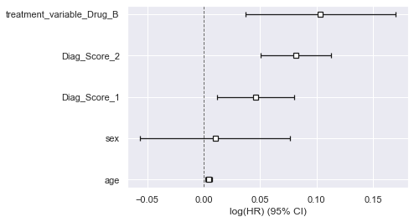
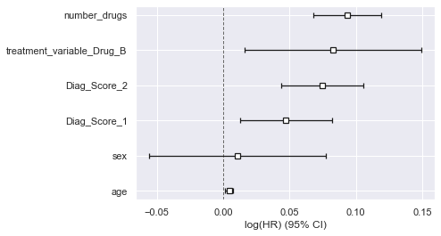
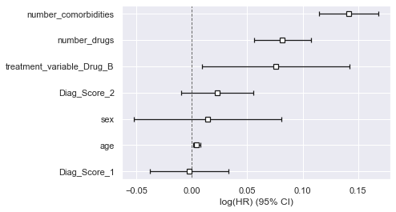
Multivariable analysis to identify confounders
Drug B results in more risk of bleeding events over time after accounting for diagnosis scores, number of drugs taken and number of comorbidities…
Cleaning
Exploratory analysis
Statistical analysis

Slide 14
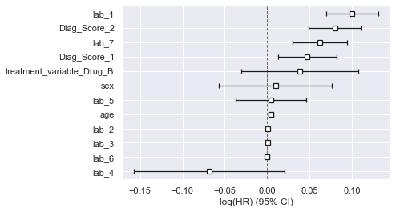
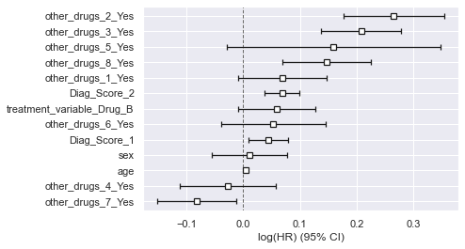
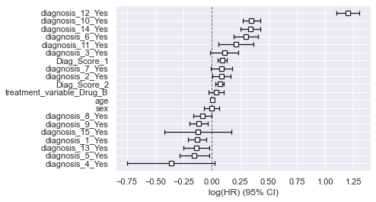
…but the treatment effect becomes non-significant after accounting for specific drugs, comorbidities and lab tests
Cleaning
Exploratory analysis
Statistical analysis

Slide 15
Conclusions
There is no evidence to indicate any difference in the occurrence of bleeding events between drugs A and drug B
Any significant difference observed between both drugs is likely to be confounded by other drugs, comorbidities and lab results
The following variables showed the strongest confounding effect size
diagnosis_12
other_drugs_2
lab_1 and lab_7

Slide 16
Next steps
Run stratified analysis by strong confounders (e.g. ‘diagnosis_12’) to test treatment differences
Alternative: use data driven feature importance algorithms (e.g. random forest) to guide stratification
Sensitivity analysis with Accelerated Failure Time (AFT) models, since two covariates (Diag_score_2 and lab_5) did not meet proportionality of hazards assumptions required for Cox regression

